Slide 1


Andrew Jones
10/02/24
https://github.com/AJones545/IBM-DS-Submissions/tree/main/CapstoneScripts

Slide 2
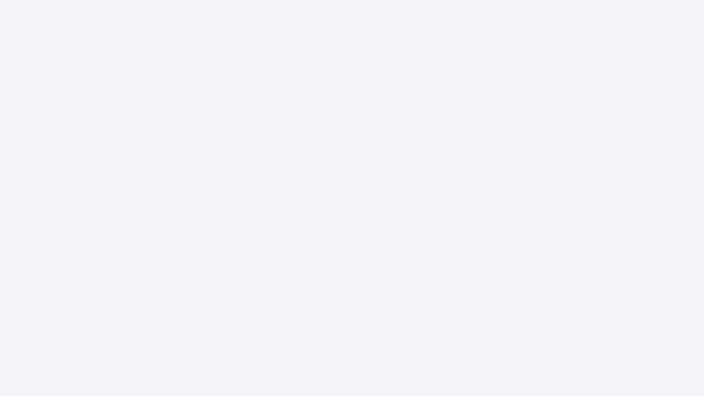
Outline
Executive Summary
Introduction
Methodology
Results
Conclusion
Appendix

Slide 3
Executive Summary
Creation of an effective classifier model used to predict the likelihood of SpaceX landing success.
To achieve this;
Historical mission data was collected,
Data was cleansed,
Missing values were handled as well as implicit information extracted,
Analysis was performed,
Predictor Classifier models were created and compared.
This yielded;
A Decision tree classifier that proved most effective at predicting failed SpaceX missions.

Slide 4
Introduction
As chief DS of SpaceY, I’ve analysed the performance of SpaceX, these insights can inform our strategy to enter the sector and glean a competitive advantage over them.
SpaceX is the most accomplished company operating in the space sector, a large reason for this is that they can land and reuse their rockets.
Rocket launches and payloads are allocated through contracts; By predicting the conditions under which SpaceX will fail landing, we can win contracts and enter the market.

Slide 5

Section 1

Slide 6
Methodology
Executive Summary
Data collection methodology:
Perform data wrangling,
Perform exploratory data analysis (EDA) using visualization and SQL,
Perform interactive visual analytics using Folium and Plotly Dash,
Perform predictive analysis using classification models.

Slide 7
Data Collection
Data sets were collected through two methodologies:
API Calls:
Data was taken from the SpaceX API with HTTP requests.
Web Scrapping:
HTTP requests and text parsing with BeautifulSoup.

Slide 8
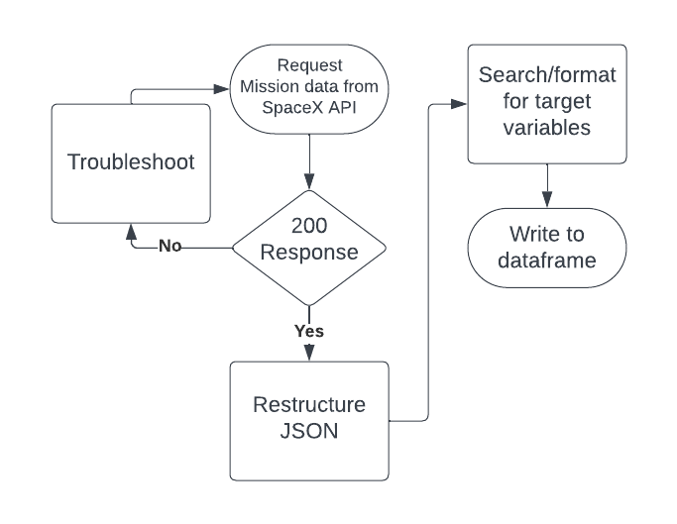
Data Collection – SpaceX API
Used a requests library to retrieve API data from: https://api.spacexdata.com/v4/launches/past
(Get request)
Restrucured the raw JSON;
Pandas normalize function,
Took target variables,
Wrote to dataframe;
Filled dictionary with target variables and converted.
github - Data Collection – SpaceX API

Slide 9
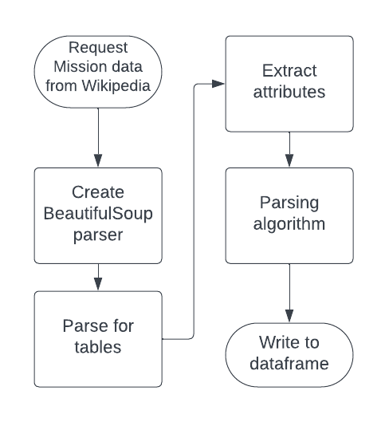
Data Collection – WebScraping (I - summary)
Web Scraping process
Get request to retrieve the data from: https://en.wikipedia.org/w/index.php?title=List_of_Falcon_9_and_Falcon_Heavy_launches&oldid=1027686922
Used beautiful soup to parse for relevant information – ‘parsing algorithm’.
Created a Dataframe of relevant information.
github - Data Collection - WebScraping

Slide 10
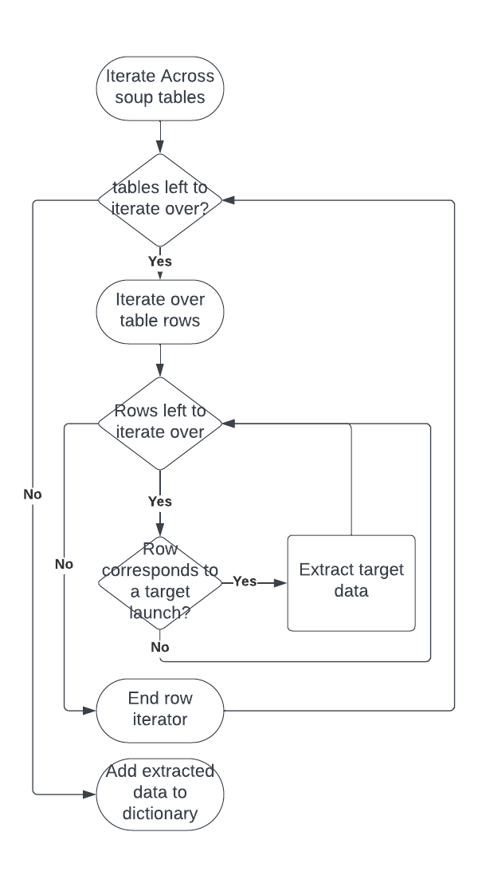
Data Collection – WebScraping (ii – Parsing algo.)
The parsing algorithm iterated across soup tables and rows.
Found target data and extracted it.
Then filled a dictionary, ready to convert to a dataframe.
Parsing Algorithm:
github - Data Collection - WebScraping

Slide 11
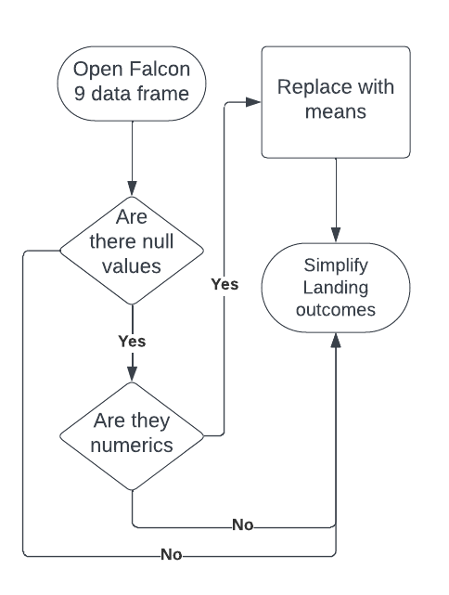
Data Wrangling (i-missing values)
Payload masses were missing.
Replaced by the average.
Launch sites were also missing.
Impossible to interpolate these.
github - Data Wrangling

Slide 12
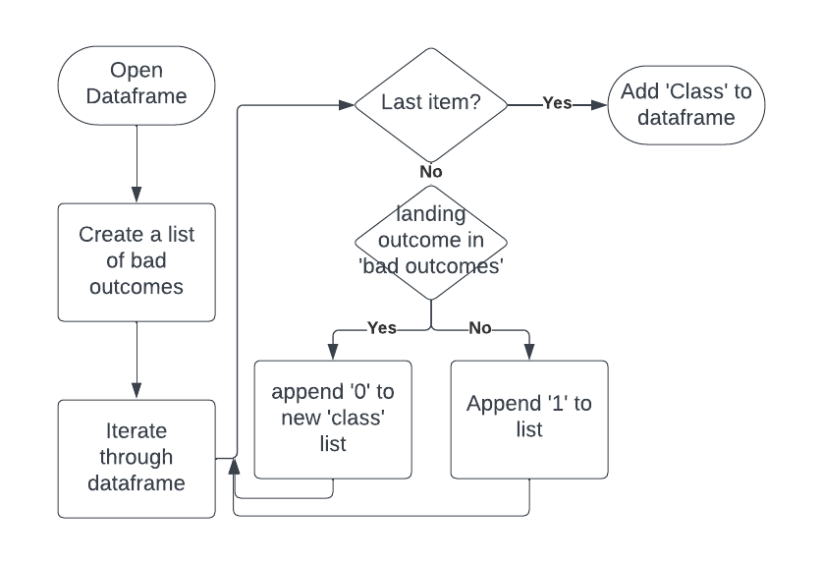
Data Wrangling (ii-cleansing data)
Landing outcomes were overcomplicated.
Included landing location -
unnecessary.
Replaced with binary to indicate
success – ‘Class’ attribute.
github - Data Wrangling

Slide 13
EDA with Data Visualization
Many charts were plotted, uncovering the relationship between various variables and landing Outcome. (Class)
Effect of payload mass and launch site? – categorical plots.
Payload mass against flight number with class.
Launch site against flight number with class.
Launch site against payload mass with class.
Effect of Orbits?
Bar - orbit against success rate (average of class).
Scatter - orbit against flight number with class.
Improvement over time? – line plot of success rate against years.
github EDA with Data Visualisation

Slide 14
EDA with SQL
SQL queries were employed through Jupyter notebook sql magics.
This provided some specific information about the data:
Launch site names, first launch information from a given site:
The sum of all payload mass carried by NASA, average payload carried by ‘Falcon9 v1.1’, earliest successful ground pad landing:
Boosters with successful droneship landings, while carrying 4-6 tones, number of successful and failed missions, boostsers which have carried max payload:
Ranked count of landing outcomes between 2010-6-4 and 2017-3-20.
github-EDA-sqlite

Slide 15
Build an Interactive Map with Folium
The Python library folium was used to show information about launch sites geographically.
A Folium Markers were used to show locations of launch sites.
Folium marker clusters were used to show which missions (of a particular site) had successful landings.
Folium polylines and markers were used to show the distances from the Cape Canaveral space launch complex and its important proximities.
github-Folium-site-map

Slide 16
Build a Dashboard with Plotly Dash
A Plotly-Dash Dashboard was created, this contained:
A pie of proportions of landing site use,
A pie of success at each site,
A scatter of payload success vs weight, with each booster type indicated and a sliding scale for weights.
These were all created with the ‘plotly.express’ module from the library: plotly. The web application was created with the dash library.
github-Dashboard-Plotly-Dash

Slide 17
Predictive Analysis (Classification)
Many Classifier models were built to predict successful landings of Spacex rockets.
These were all part of the scikit-learn python library:
Logistic Regression,
Support Vector Classification (a Support Vector Machine),
Decision Tree Classifier,
K Nearest Neighbor Classifier.
Grid Search Cross Validation was used to tune hyperparameters and train-test-split was used to test out of sample accuracy.
github-Machine-Learning-Prediction

Slide 18
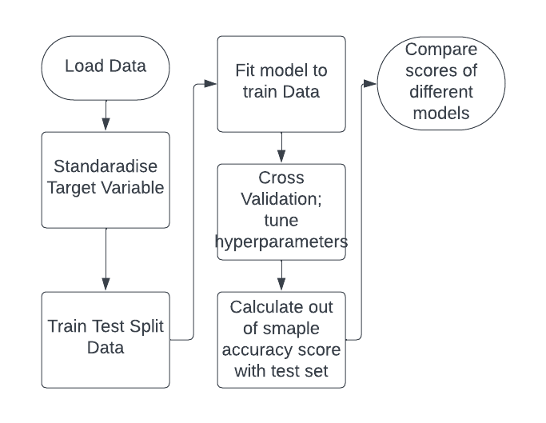
Predictive Analysis (Classification) - Flowchart
Flow of the model building Process:
github-Machine-Learning-Prediction

Slide 19
Results
Exploratory data analysis results
Interactive analytics demo in screenshots
Predictive analysis results

Slide 20

Section 2

Slide 21
Convention
The ‘Class’ indicates whether landing was successful:
1 – Success,
0 – Failure,
1<x<0 – success rate/ predicted success rate.

Slide 22
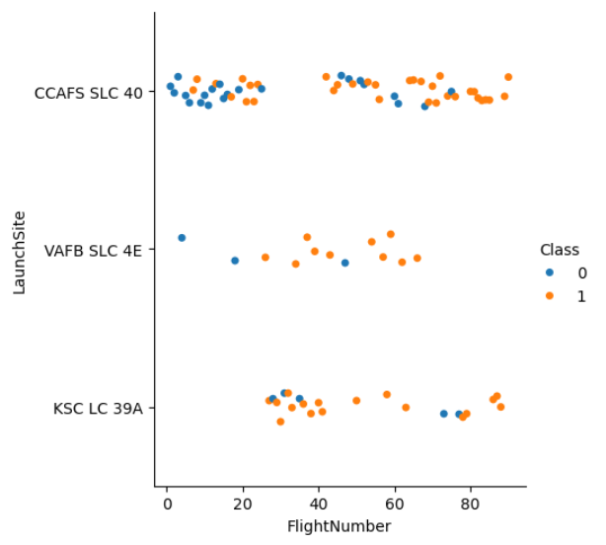
Flight Number vs. Launch Site
CCAFS SLC 40 is the most popular launch site.
Early flights (<20) had a high failure rate.
Recent flights (>60) have a high success rate.

Slide 23
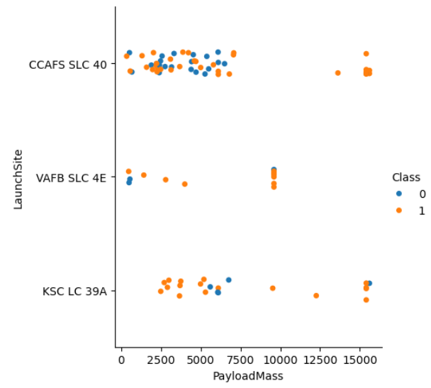
Payload vs. Launch Site
The largest payloads have been launched at CCAFS SLC 40 and KSC LC 39A:
They have a high success rate.
Potentially due to additional care taken to ensure the payload value is not lost.
Smaller payloads may have been discarded without concern.

Slide 24
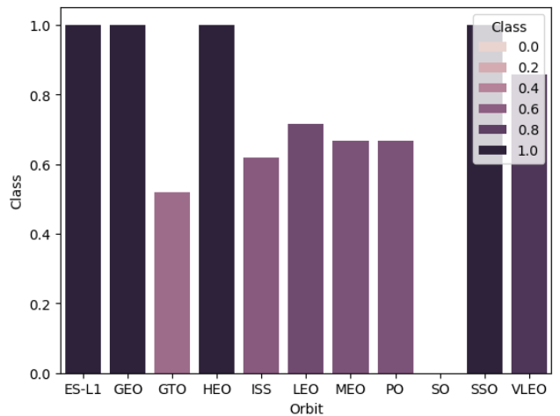
Success Rate vs. Orbit Type
The low success rate of GTO–transfer orbits is likely due to their high usage:
These are used to launch a lot of satellites.
Large success of ES-L1, HEO, GEO due to only being used once.

Slide 25
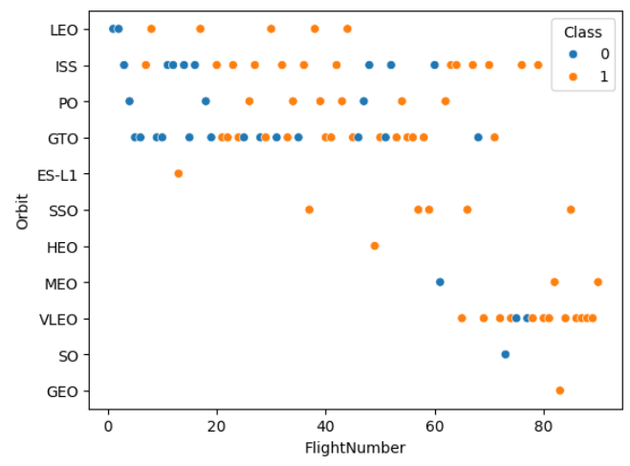
Flight Number vs. Orbit Type
SSO success rate is impressive.
LEO’s success rate so early is impressive:
May be due to it being a short trip.

Slide 26
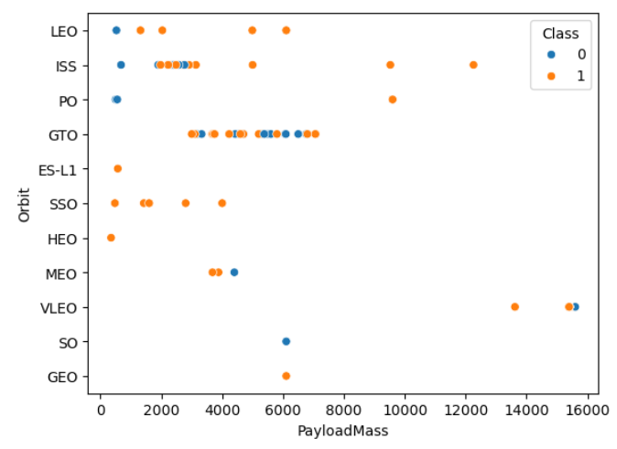
Payload vs. Orbit Type
VLEO only ships larger payloads;
Potentially since there is less chance of losing the payload.
SSO only ships smaller loads.

Slide 27
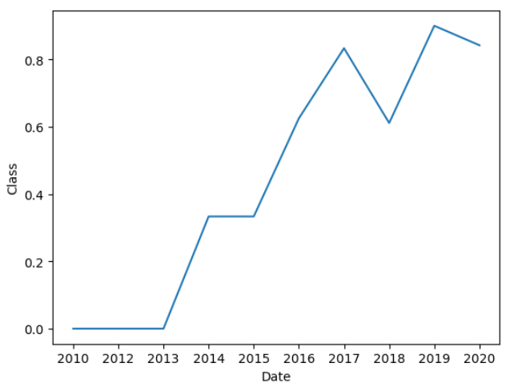
Launch Success Yearly Trend
Success Rate has increased since 2013.
It is leveling out:
More ambitious orbit/ payloads attempted over time.

Slide 28
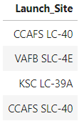
All Launch Site Names
Florida Launch Sites:
Cape CAnaveral space Force Station:
CCAFS LC-40,
CCAFS SLC-40. (Space Launch Complex)
Kennedy Space Centre:
KSC LC-39A.
California Launch Site:
VAFB SLC-4E.
(Vandenberg Space Force Base)

Slide 29
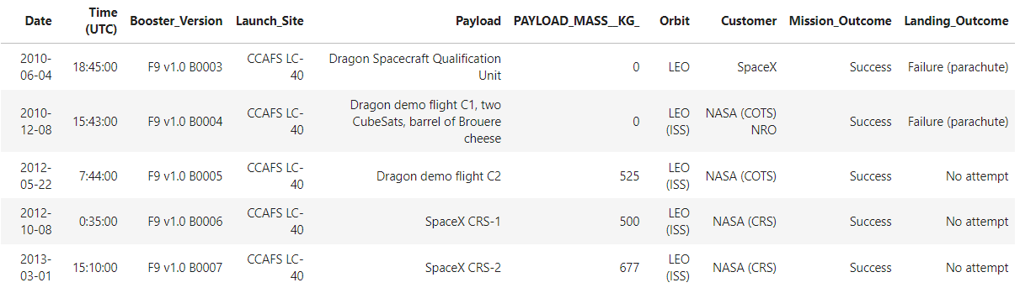
Launch Site Names Begin with 'CCA'
Launch site LC-40 was the precurssor to SLC-40 ‘Slick 40’.

Slide 30
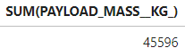
Total Payload Mass
NASA (CRS) total payload mass.
NASA CRS (Commercial ReSupply) are contract missions used by NASA to ship cargo to the ISS.
There’s a lot of cargo they want to ship up there.
These are the contracts we want to start winning.

Slide 31
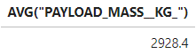
Average Payload Mass by F9 v1.1
Unsurprisingly, the early booster version can’t carry as much as the more recent iterations.

Slide 32
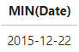
First Successful Ground Landing Date
Rocket re-usability is a relatively recent achievement.

Slide 33
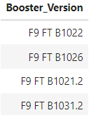
Successful Drone Ship Landing with Payload between 4000 and 6000
Names of boosters that have successfully landed on the drone ship pad and had payload mass greater than 4000 but less than 6000.
These Boosters are the second latest generation of Falcon 9 rockets – ‘Full Thrust.’
These rockets can’t carry as heavy payloads as the Block fives – hence none are on the list.

Slide 34
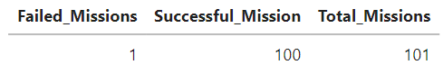
Total Number of Successful and Failure Mission Outcomes
There’s a reason SpaceX is the sector leader: they have many successful missions.
Although this could be clever marketing; a mission can be considered a success, but the landing might fail.
They could have delivered a payload to space but not been able to achieve the secondary objective of retrieving the rocket.

Slide 35
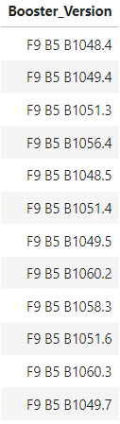
Boosters That Carried Maximum Payload
All Falcon 9 Block 5 boosters.
These are the latest booster version.
They have strong rockets with high thrust, allowing them to carry heavier payloads.

Slide 36
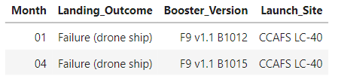
2015 Launch Records
Failed landing_outcomes in drone ship, their booster versions, and launch site names for in year 2015.

Slide 37
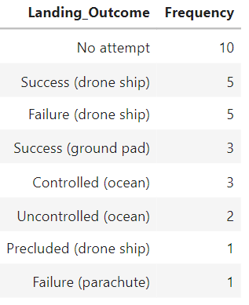
Rank Landing Outcomes Between 2010-06-04 and 2017-03-20
Ranked count of landing outcomes between the date 2010-06-04 and 2017-03-20, in descending order.
This period is where attempts started – most common outcome is no attempt.
Drone ship was the most used method.
Ground pad has the highest success rate.

Slide 38

Section 3

Slide 39
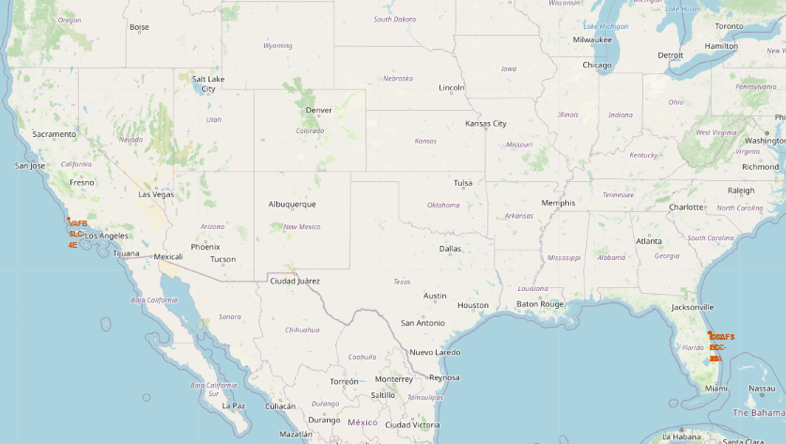
Launch Site Map (i – overview)
Launch sites are in Florida and California.

Slide 40
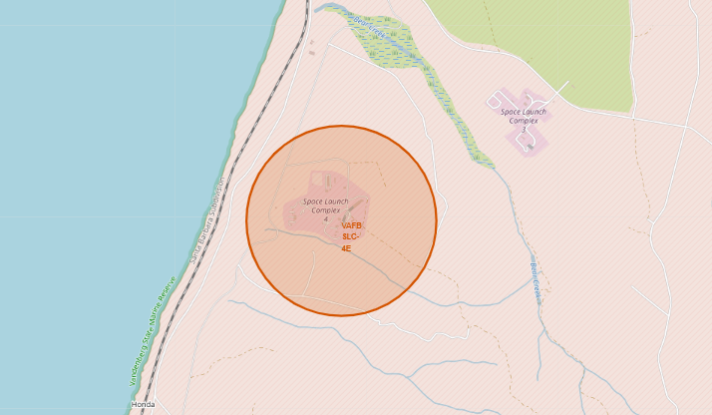
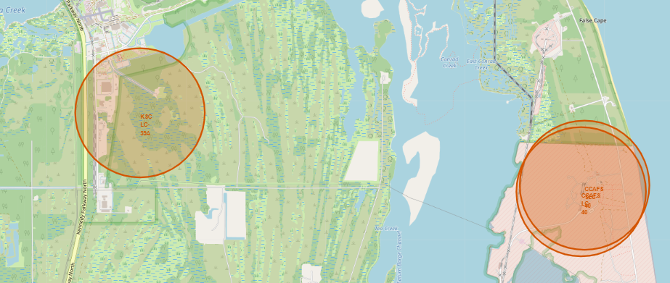
Launch Site Map (ii – Specifics)
California Launch site.
At Vandenberg Space Force Base, Space Launch complex 4. (VAFB SLC-4E)
Florida Launch sites.
Left: Kennedy Space Centre Launch Complex 39. (KSC-LC39A)
Right: Cape Canaveral Space Force Station, Launch Complex 40 and Space Launch Complex 40. (CCAFS – LC, CCAFS – SLC40)

Slide 41
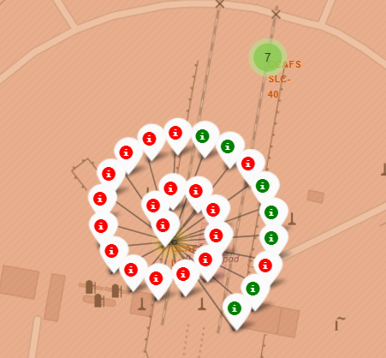
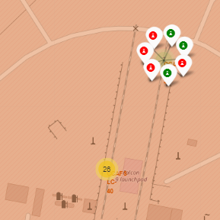
Interactive Map displaying Landing Class (i – Cape Canaveral)
Graphics showcasing landing (and rocket re-use) success at each launch site.
Left: The interactive map, focused on CCAFS LC-40, shows a large number of launches with a high failure rate.
Right: CCAFS SLC-40 shows fewer launches with a slight negative bias.

Slide 42
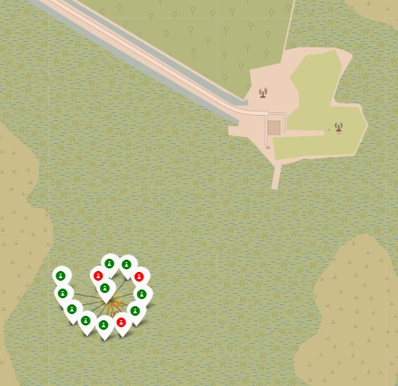
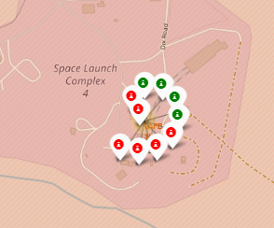
Interactive Map displaying Landing Class
(ii –Kennedy and California)
Left: Kennedy (KSC-LC39A) has a large success rate!
Right: VAFB SLC-4E, the California site has a negative bias.

Slide 43
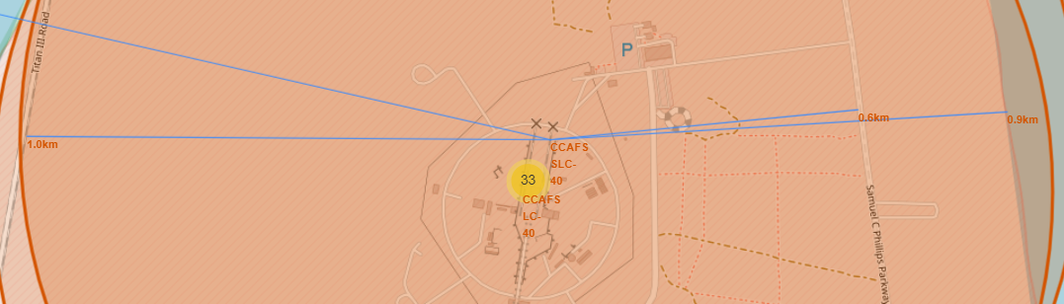
Cape Canaveral Space Launch Complex Close Proximities
‘Slick 40’ is close to the coastline; less than a kilometer away!
It’s well connected to transport routes; a railway is a kilometer away and a highway is just over half a kilometer away.

Slide 44
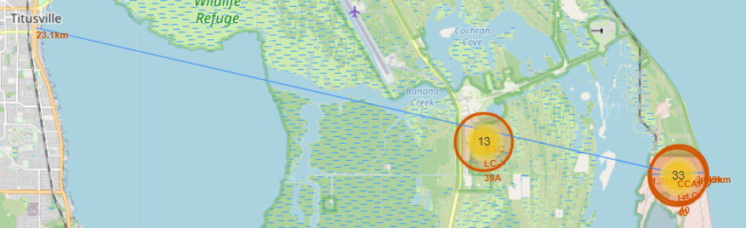
Cape Canaveral Space Launch Complex Nearest City
‘Slick 40’ is close to two cities, Cape Canaveral and Titusville.
Titusville is 23.1 kilometers away.

Slide 45

Section 4

Slide 46
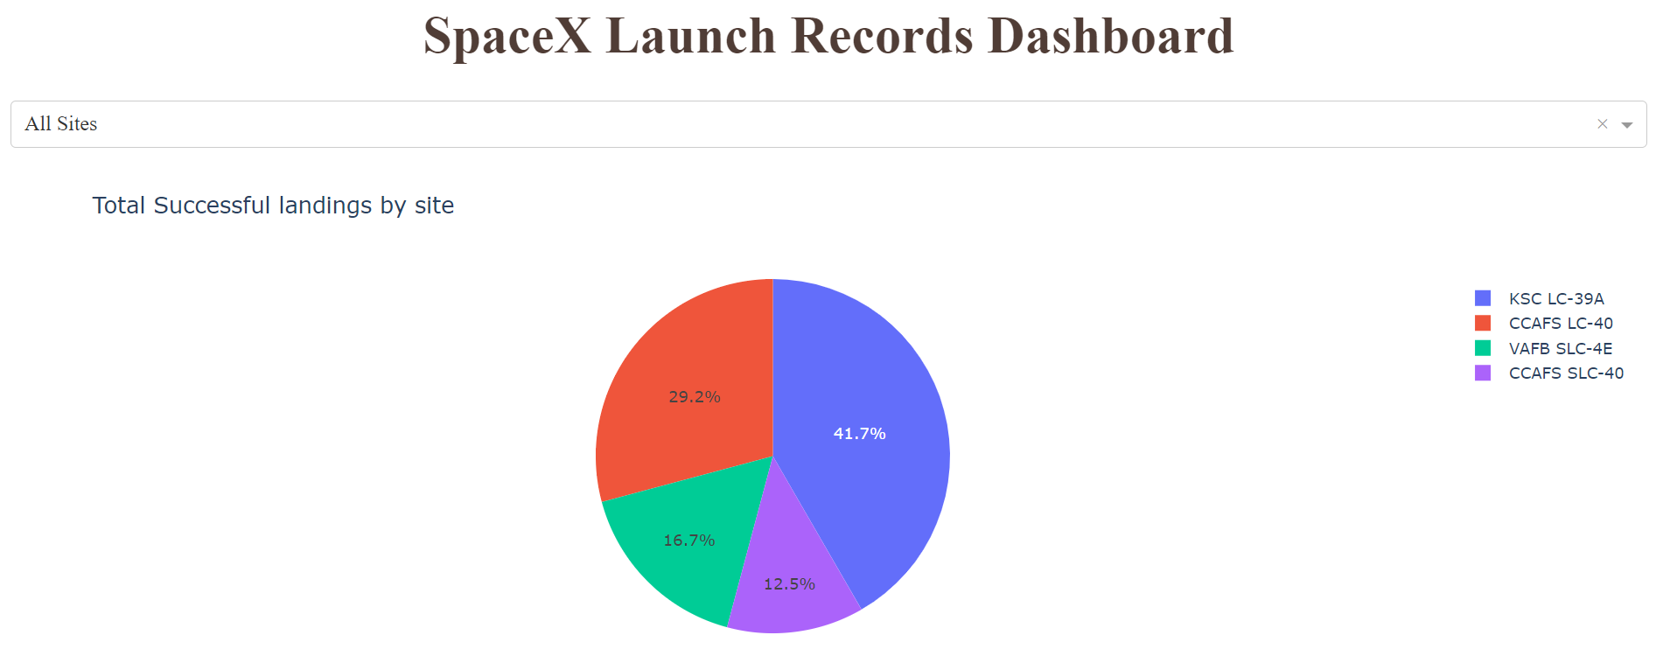
Launch Site Use Proportions
The Kennedy launch site has the most successful landings!

Slide 47
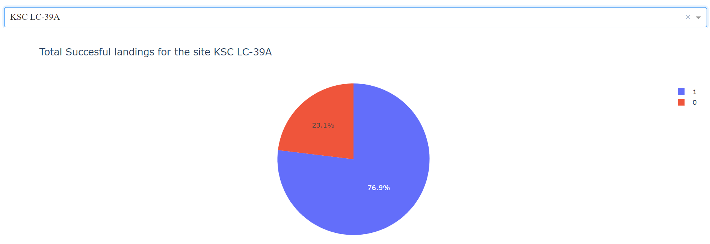
Most successful Launch Site
The Kennedy site also has the highest proportion of successful landings.

Slide 48
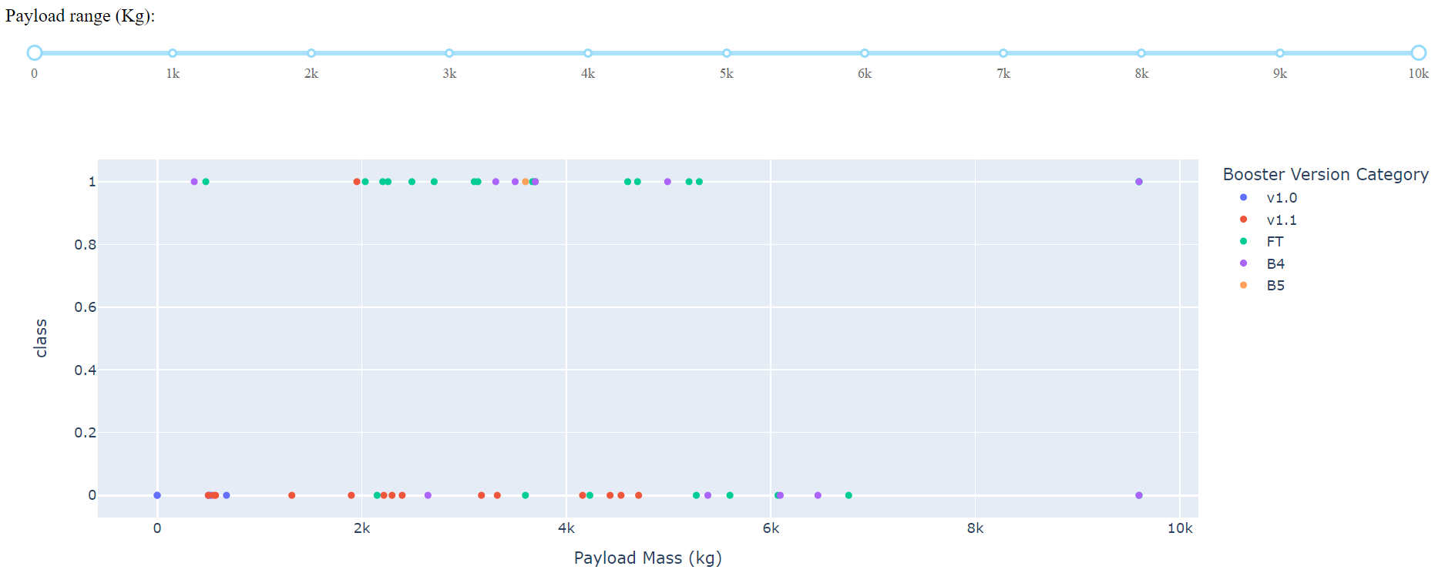
Success by mass by Booster type (i)

Slide 49
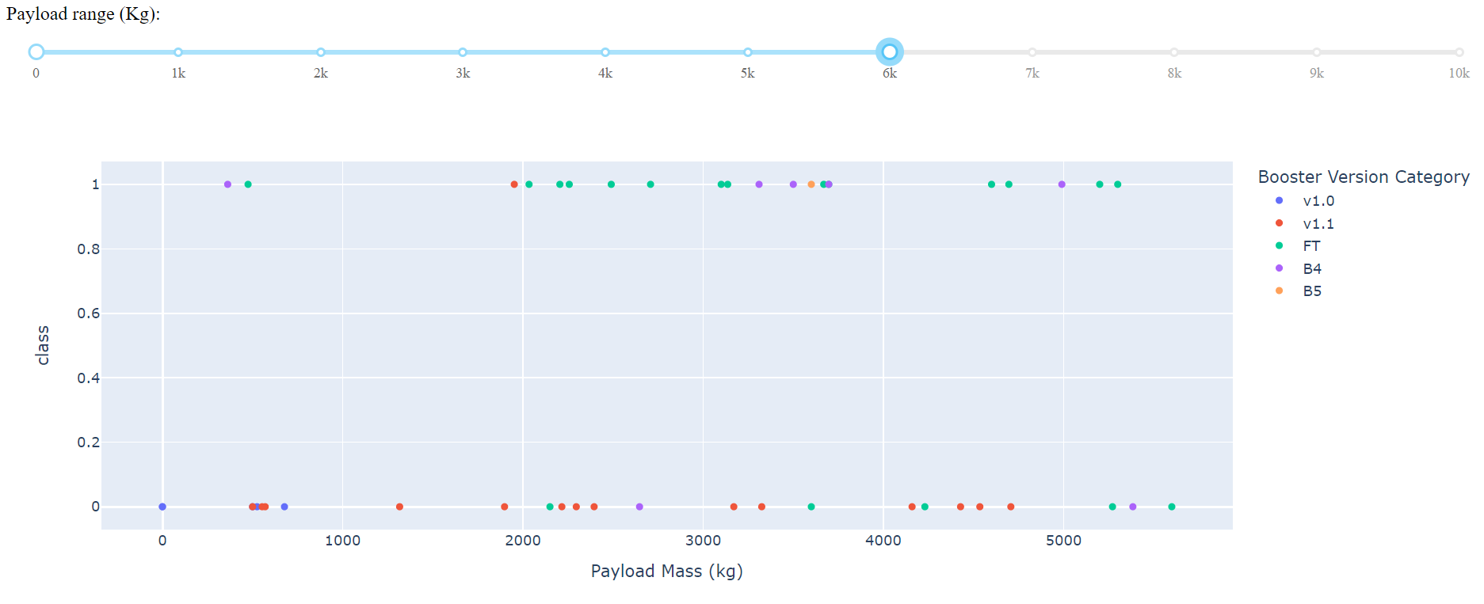
Success by mass by Booster type (ii)
The most successes occur between 2 and 4 tons of payload.

Slide 50

Section 5

Slide 51
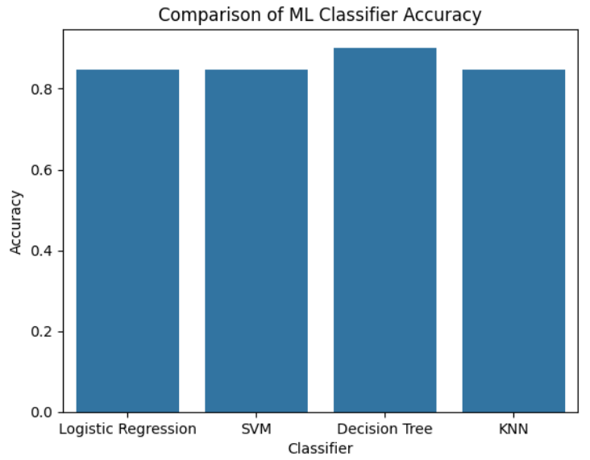
Classification Accuracy
The most accurate classifier was the decision tree!
All other models yielded the same accuracy.

Slide 52
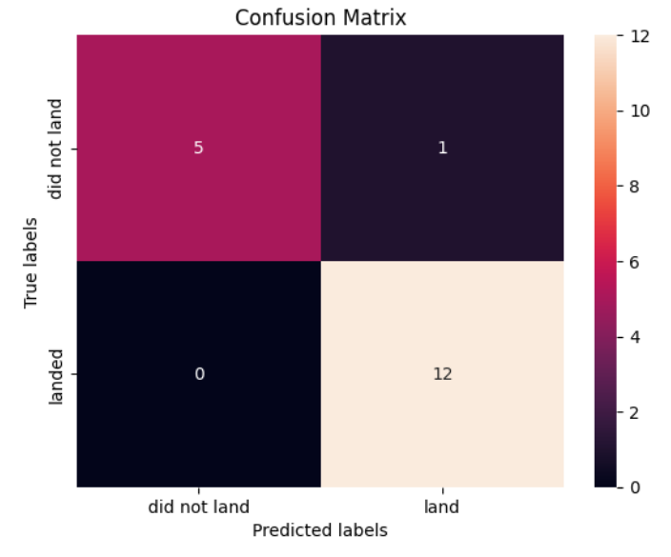
Confusion Matrix
The decision tree classifier only predicted one element of the test data wrong – a false positive.
5 true negatives and 12 true positives.

Slide 53
Conclusions
Moving forward, the decision tree model will be implemented for use as a predictor of SpaceX landing performance.
Contract details can be fed into the model to predict landing success;
Strategically, We can bid for SpaceX landings that are more likely to fail and begin to compete in the market.

Slide 54


